Slide 1
Programming Fundamentals Lecture #7 Functions
Junaid Hassan
Lecturer CS & IT Department UOS MBDIN
junaidte14@gmail.com

Slide 2
Functions
Objectives:
To construct programs modularly from small pieces called functions
Common math functions in C standard library
How to create new functions
The mechanism used to pass information between functions
How to write and use functions that call themselves
Function definitions, Function call stack and activation records, Headers, Calling functions by values and by reference, scope rules, Recursion, Fibonacci series, Recursion vs iteration

Slide 3
Functions
The best way to develop and maintain a large program is to construct it from smaller pieces or modules, each of which is more manageable than the original program.
This technique is called divide and conquer technique
The small modules/pieces in C are called functions
Sometimes we use already available functions from C standard library
Sometimes we have to develop new functions for our custom requirements

Slide 4
Functions
The C Standard Library provides a rich collection of functions for performing common mathematical calculations, string manipulations, character manipulations, input/output, and many other useful operations
Avoid reinventing the wheel. When possible, use C Standard Library functions instead of writing new functions. This can reduce program development time

Slide 5
Functions
Functions are invoked by a function call, which specifies the function name and provides information (as arguments) that the called function needs to perform its designated task
A common analogy for this is the hierarchical form of management. A boss (the calling function or caller) asks a worker (the called function) to perform a task and report back when the task is done.
For example, a function needing to display information on the screen calls the worker function printf to perform that task, then printf displays the information and reports back—or returns—to the calling function when its task is completed

Slide 6
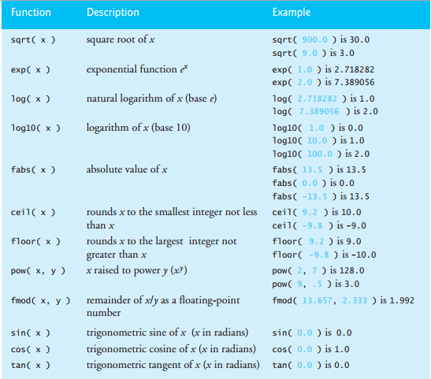
Common Math Functions

Slide 7
Functions
Functions allow you to modularize a program.
All variables defined in function definitions are local variables—they’re known only in the function in which they’re defined.
Most functions have a list of parameters that provide the means for communicating information between functions.
A function’s parameters are also local variables of that function
Each function should be limited to performing a single, well-defined task, and the function name should express that task. This facilitates abstraction and promotes software reusability

Slide 8
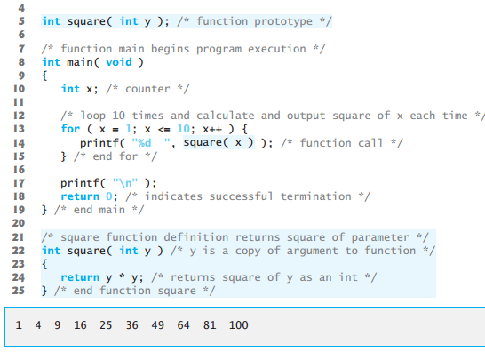
Function Definitions

Slide 9
Function Definitions (Code Explanation)
Function square is invoked or called in main within the printf statement (line 14)
Function square receives a copy of the value of x in the parameter y (line 22).
Then square calculates y * y (line 24). The result is passed back to function printf in main where square was invoked (line 14), and printf displays the result.
This process is repeated 10 times using the for repetition statement

Slide 10
Function Definitions (Code Explanation)
Line 5 is a function prototype.
The int in parentheses informs the compiler that square expects to receive an integer value from the caller.
The int to the left of the function name square informs the compiler that square returns an integer result to the caller.
The compiler refers to the function prototype to check that calls to square (line 14) contain the correct return type, the correct number of arguments, the correct argument types, and that the arguments are in the correct order

Slide 11
Function Definitions (Code Explanation)
The parameter-list is a comma-separated list that specifies the parameters received by the function when it’s called.
If a function does not receive any values, parameter-list is void.
A type must be listed explicitly for each parameter

Slide 12
Function Prototypes
A function prototype tells the compiler the type of data returned by the function, the number of parameters the function expects to receive, the types of the parameters, and the order in which these parameters are expected.
The compiler uses function prototypes to validate function calls

Slide 13
Function Call Stack and Activation Records
To understand how C performs function calls, we first need to consider a data structure (i.e., collection of related data items) known as a stack.
Students can think of a stack as analogous to a pile of dishes. When a dish is placed on the pile, it’s normally placed at the top (referred to as pushing the dish onto the stack). Similarly, when a dish is removed from the pile, it’s always removed from the top (referred to as popping the dish off the stack).
Stacks are known as last-in, first-out (LIFO) data structures—the last item pushed (inserted) on the stack is the first item popped (removed) from the stack

Slide 14
Function Call Stack and Activation Records
When a program calls a function, the called function must know how to return to its caller, so the return address of the calling function is pushed onto the program execution stack (sometimes referred to as the function call stack).
If a series of function calls occurs, the successive return addresses are pushed onto the stack in last-in, first-out order so that each function can return to its caller

Slide 15
Function Call Stack and Activation Records
The program execution stack also contains the memory for the local variables used in each invocation of a function during a program’s execution. This data, stored as a portion of the program execution stack, is known as the activation record or stack frame of the function call.
When a function call is made, the activation record for that function call is pushed onto the program execution stack. When the function returns to its caller, the activation record for this function call is popped off the stack and those local variables are no longer known to the program

Slide 16
Function Call Stack and Activation Records
Of course, the amount of memory in a computer is finite, so only a certain amount of memory can be used to store activation records on the program execution stack.
If more function calls occur than can have their activation records stored on the program execution stack, an error known as a stack overflow occurs.

